Slide 1


SMART AGRICULTURE RECOMMENDATION SYSTEM
BY MACHINE LEARNING APPROACH
PRESENTED BY
GENJI RUSHIKESH RAGHAVAMSI - 206Q1A4209
DHULIPUDI VEERA VENKATA SWAMINADH - 206Q1A4205
KINTADA VEERA VENKATA ARAVIND - 206Q1A4210
POLAMURI SUBBA RAO - 216Q5A4203
UNDER THE ESTEEMED GUIDANCE OF
Mr. V V SUBASH, M.Tech, Assistant Professor
KAKINADA INSTITUTE OF ENGINEERINNG & TECHNOLOGY - II
DEPARTMENT OF CSE – ARTIFICIAL INTELLIGENCE AND MACHINE LEARNING

Slide 2
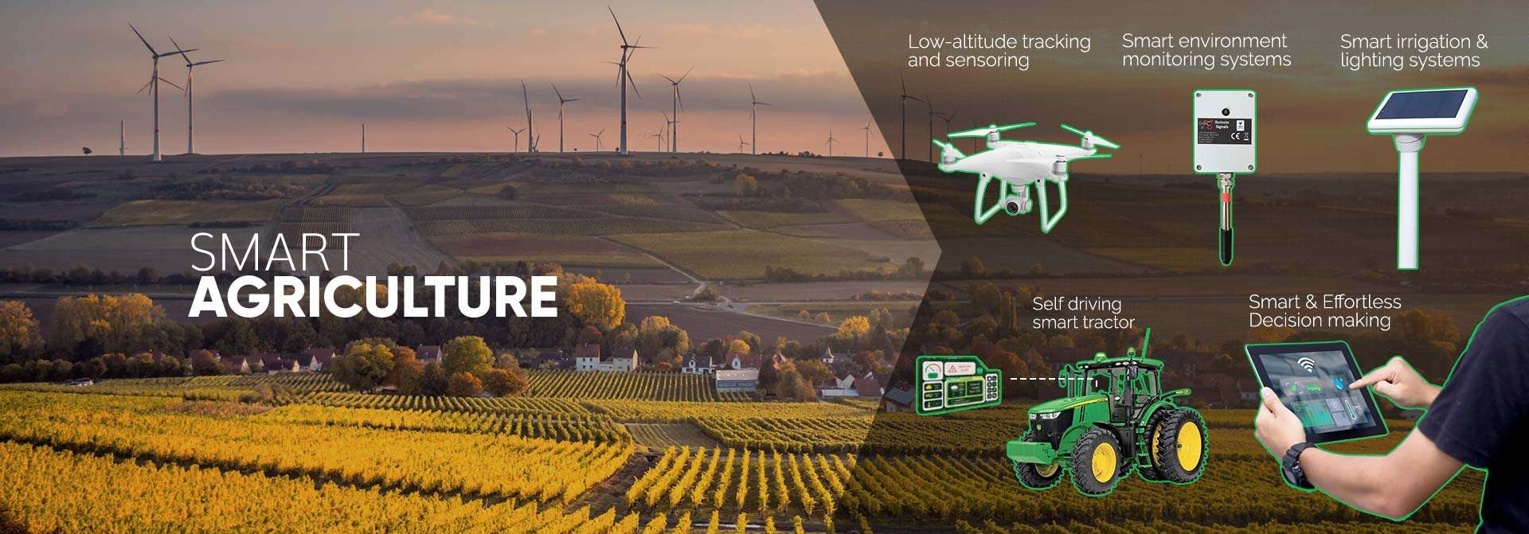
PROPOSED METHODS

Slide 3
List of Contents
Abstract
Introduction
Challenges in traditional farming
Role of machine learning in agriculture
Implementation of smart agriculture
Data set graph
Evaluation and optimization of the model
Seaborn temperature chat
Benefits of the smart agriculture system
System requirement
Output screens
Future enhancements
Conclusion
Thank you

Slide 4
Abstract
Agriculture is the largest provider of livelihoods in rural India and a significant contributor to the country's GDP. However, crop yield per hectare is low compared to international standards, contributing to the high suicide rate among marginal farmers. To address this, we propose a user-friendly yield prediction system accessible via a mobile app. By using GPS to identify location and accepting area and soil type as inputs, the system employs machine learning algorithms to suggest the most profitable crops or predict yields. Random Forest, with 95% accuracy, performs the best. The app also advises on optimal fertilizer use to enhance yield.

Slide 5
Introduction
India's agricultural sector faces challenges like suboptimal crop yields and limited access to information, especially for marginal farmers, leading to economic hardship and high suicide rates. A smart agriculture recommendation system using machine learning can provide personalized, actionable insights. Accessible via mobile, it analyzes soil type and historical yield data to advise on crop selection, cultivation practices, and fertilizer timing. This system aims to enhance productivity, improve livelihoods, and reduce farmer distress in rural India.

Slide 6
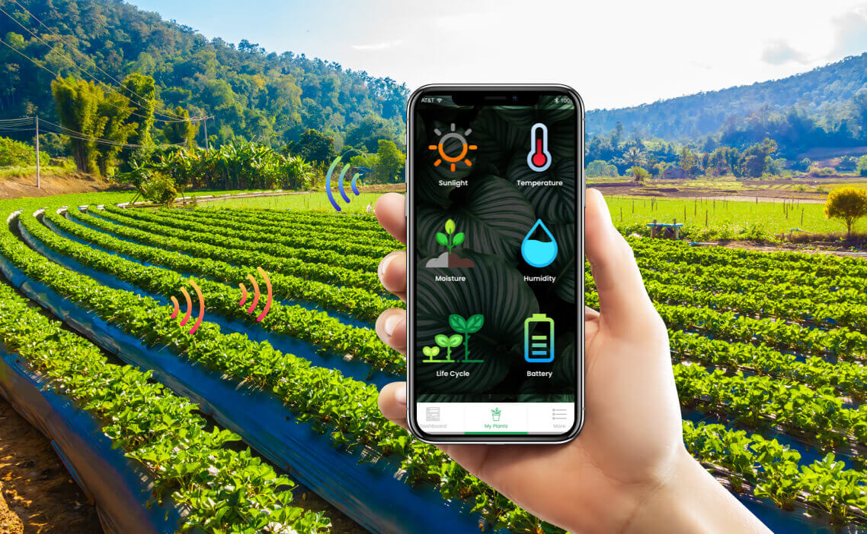
A BEST WAY TO CULTIVATE
THE CROP

Slide 7
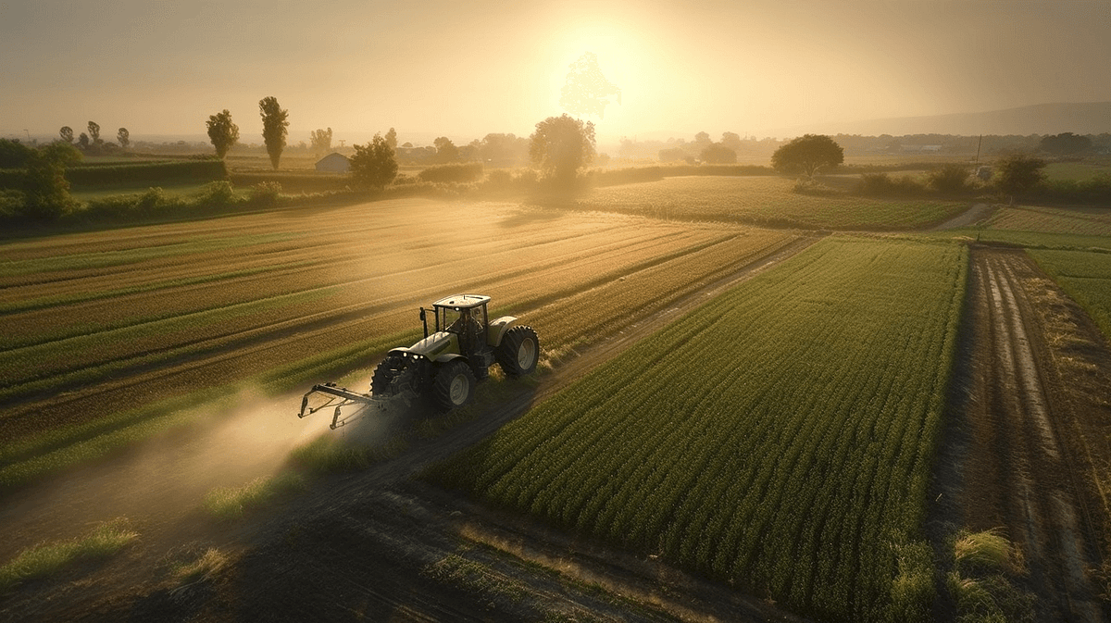
CHALLENGES IN TRADITIONAL FARMING
Dependency on unpredictable weather patterns and climate change, leading to crop failures and reduced yields.
Inefficient use of resources, such as water and fertilizers, due to lack of precision in farming techniques.
Difficulty in pest and disease management, leading to significant crop losses and increased use of harmful pesticides.

Slide 8
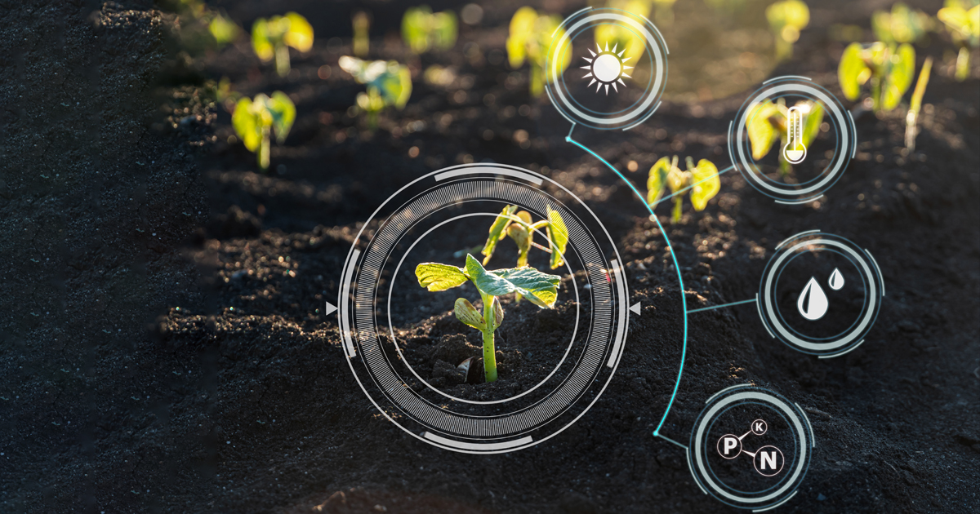
Role of Machine Learning in Agriculture
Machine learning algorithms can analyze vast amounts of agricultural data to uncover valuable insights. These insights can help farmers optimize crop yields, reduce waste, and adapt to changing environmental conditions.
By leveraging machine learning, farmers can make more informed decisions about planting, irrigation, pest control, and harvesting, leading to increased productivity and sustainability.

Slide 9

Implementation of Smart Agriculture
Data Collection: Gather comprehensive data on crop types, soil properties, weather conditions, fertilizer usage, and historical yields.
Data Preprocessing: Clean the data by handling missing values and outliers
Model Training: Train and optimize the selected models on the training data using techniques like grid search and cross-validation.
Model Selection: Experiment with machine learning algorithms such as SVM, ANN, Random Forest, MLR, and KNN.

Slide 10
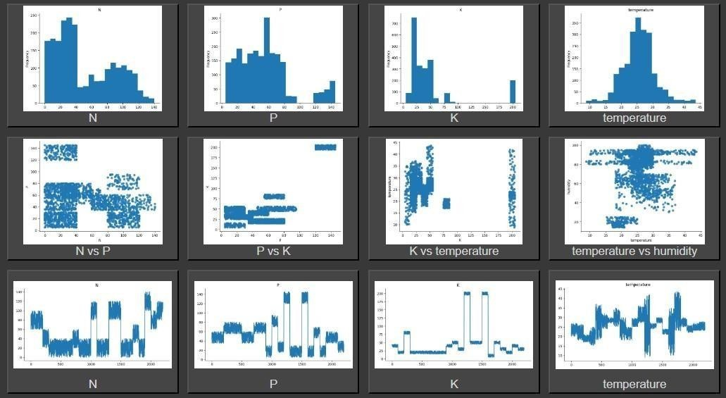
Data Set Graph

Slide 11

Evaluation and Optimization of the Model
PERFORMANCE METRICS
CROSS-VALIDATION
HYPER PARAMETER TUNING
Evaluate the model's accuracy, precision, recall, and F1-score to ensure it is making reliable crop recommendations.
Conduct cross-validation to assess the model's generalization ability and identify potential overfitting or underfitting.
Fine-tune the model's hyperparameters, such as learning rate, regularization, and the number of hidden layers, to optimize its performance.

Slide 12
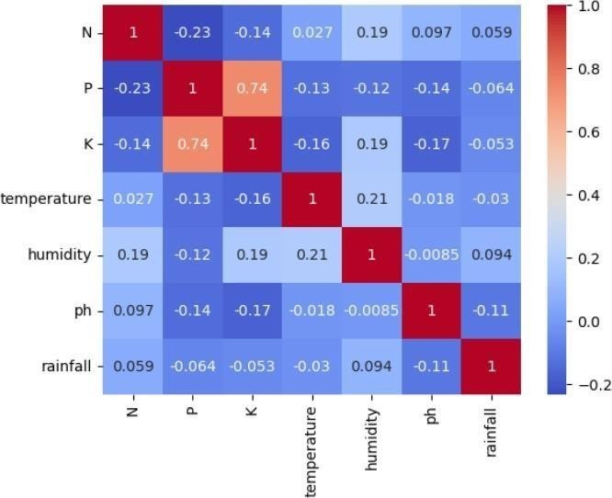
Seaborn Temperature Chat

Slide 13

Benefits of the Smart Agriculture System
Increased Productivity
The smart agriculture recommendation system leverages machine learning to optimize crop selection and farming practices, leading to higher yields and more efficient resource utilization.
Cost Savings
By providing data-driven recommendations, the system helps farmers reduce input costs and wastage, resulting in significant cost savings and improved profitability.
Environmental Sustainability
The smart agriculture recommendation system promotes sustainable practices, such as precision irrigation and targeted fertilizer application, minimizing the environmental impact of farming operations.
Enhanced Decision Making
The system's predictive to make more informed decisions, leading to improved crop management and resource allocation.

Slide 14
System Requirements
Operating System
Windows 10/11.
Coding Language : Python 3.7.
The system is developed using the Python programming language, so Python must be installed on the system.
IDE: Jupiter Notebook (Google Collab can also be utilized)
Libraries
The following Python libraries are required for the system:
Numpy: Numpy is python package which provide scientific and higher level mathematical abstractions wrapped in python.
Scikit : Scikit-learn could be a free machine learning library for Python.
Seaborn: For data visualization, specifically for creating heatmaps.
Few more libraries are used they are : Pandas, Matplotlib, Pickle.

Slide 15
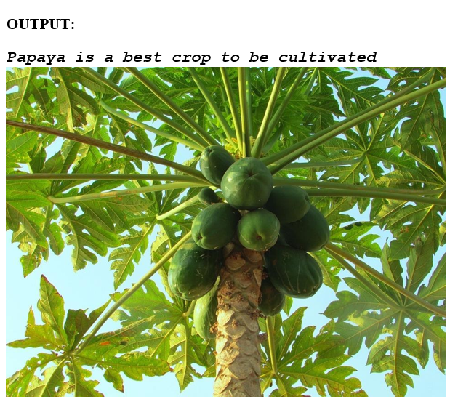
Output Screens

Slide 16

Future Enhancements
Advanced Machine Learning: Improved accuracy with deep learning.
Weather Forecasts: Predict climatic impacts on crops.
Economic Analysis: Choose crops for best economic returns.
Multi-Language Support: Accessible to diverse regions.
User Feedback: Continuously improve with farmer input.

Slide 17
Conclusion
In conclusion, the implementation of a Smart Agriculture Recommendation System Using Machine Learning has demonstrated its immense potential in revolutionizing the way we approach crop cultivation. By leveraging data-driven insights and predictive modeling, this innovative approach has empowered farmers to make more informed decisions, leading to increased yields, reduced resource consumption, and enhanced sustainability.

Slide 18

THANK YOU!

